Slide 1
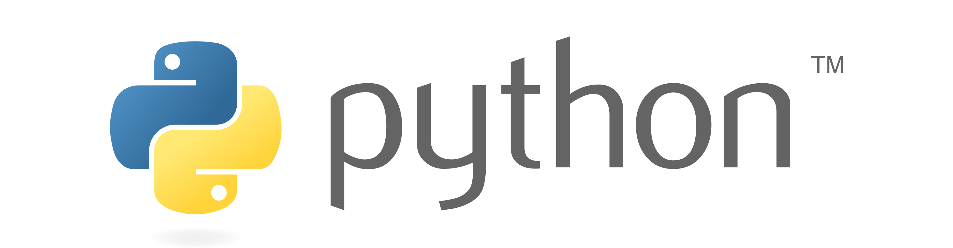

Slide 2
Abstraction
Abstraction is used to hide the internal functionality of the function from the users. The users only interact with the basic implementation of the function, but inner working is hidden. User is familiar with that "what function does" but they don't know "how it does."
Why Abstraction is Important?
In Python, an abstraction is used to hide the irrelevant data/class in order to reduce the complexity. It also enhances the application efficiency.

Slide 3
In Python, abstraction can be achieved by using abstract classes and interfaces.
A class that consists of one or more abstract method is called the abstract class. Abstract methods do not contain their implementation.
Abstract class can be inherited by the subclass and abstract method gets its definition in the subclass.
Abstraction classes are meant to be the blueprint of the other class.
An abstract class can be useful when we are designing large functions.
An abstract class is also helpful to provide the standard interface for different implementations of components.
Python provides the abc module to use the abstraction in the Python program. Let's see the following syntax.

Slide 4
Points to Remember
An Abstract class can contain the both method normal and abstract method.
An Abstract cannot be instantiated; we cannot create objects for the abstract class.
Abstraction is essential to hide the core functionality from the users.

